Slide 1
CP6 Presentation

Slide 2
Topic
Distributed-memory parallel version
of Sobel filter with the Message Passing Interface (MPI) utilizing Varied Grid Decomposition Strategies

Slide 3
Code harness
sobelAllTiles
This function designed to integrate the Sobel edge detection algorithm into a parallel computing framework using MPI. It ensures that each MPI process works on a specific part of the image, thereby leveraging the power of distributed computing to efficiently process large images.
scatterAllTiles
This function is instrumental in distributing segments of an image (tiles) across different MPI ranks for parallel processing. If rank = 0 it going to send the data to another rank, otherwise it going to receive the tile from rank 0

Slide 4
Code harness
gatherAllTiles
This function in the plays a crucial role in aggregating processed image segments (tiles) from various MPI ranks. If rank is other than 0, it going to send the processed tile to rank 0. If the rank is 0, it going to receive processed data from other rank.

Slide 5
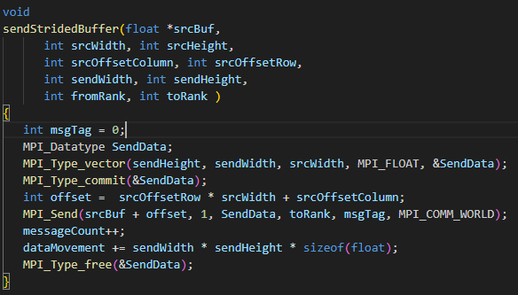
Code implementation
sendStridedBuffer
function call is responsible for sending a specifically defined subregion of a data buffer from one MPI process to another, using a custom data type to accurately describe the shape and size of the data segment being transmitted
Also keep track on message count and how much data is transferred for further analysis

Slide 6
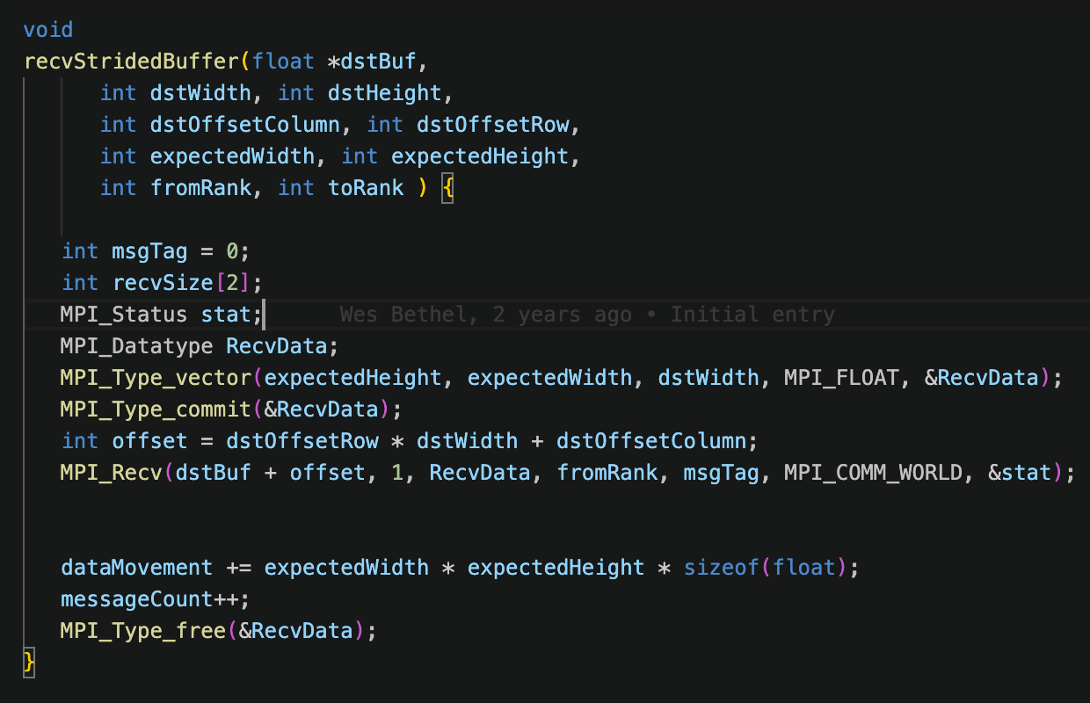
Code implementation
recvStridedBuffer
Similar to sendStridedBuffer but for receive end

Slide 7
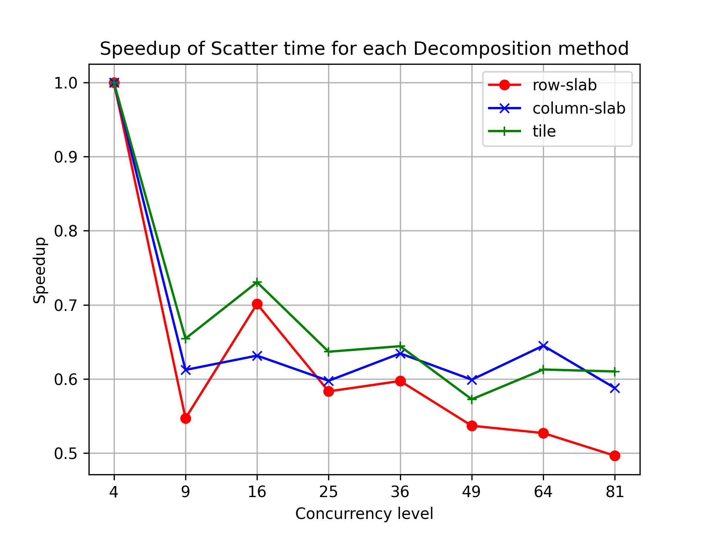
result
Scatter Speedup
In the scatter stage, all strategies showed a decrease in speedup as concurrency increased, with the row-slab strategy exhibiting the most decline. The tile strategy maintained a superior speedup at lower concurrency levels but experienced a significant reduction at a concurrency level of 9

Slide 8
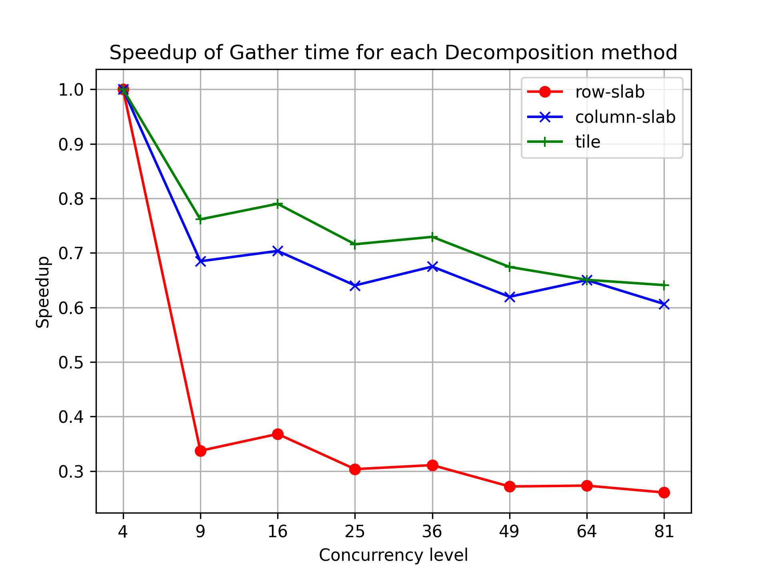
result
Gather stage, the tile strategy achieved the highest speedup at all concurrency levels, suggesting a more efficient method. Conversely, the row-slab strategy demonstrated a consistent decrease in speedup as concurrency levels rose, indicating potential data collection bottlenecks

Slide 9
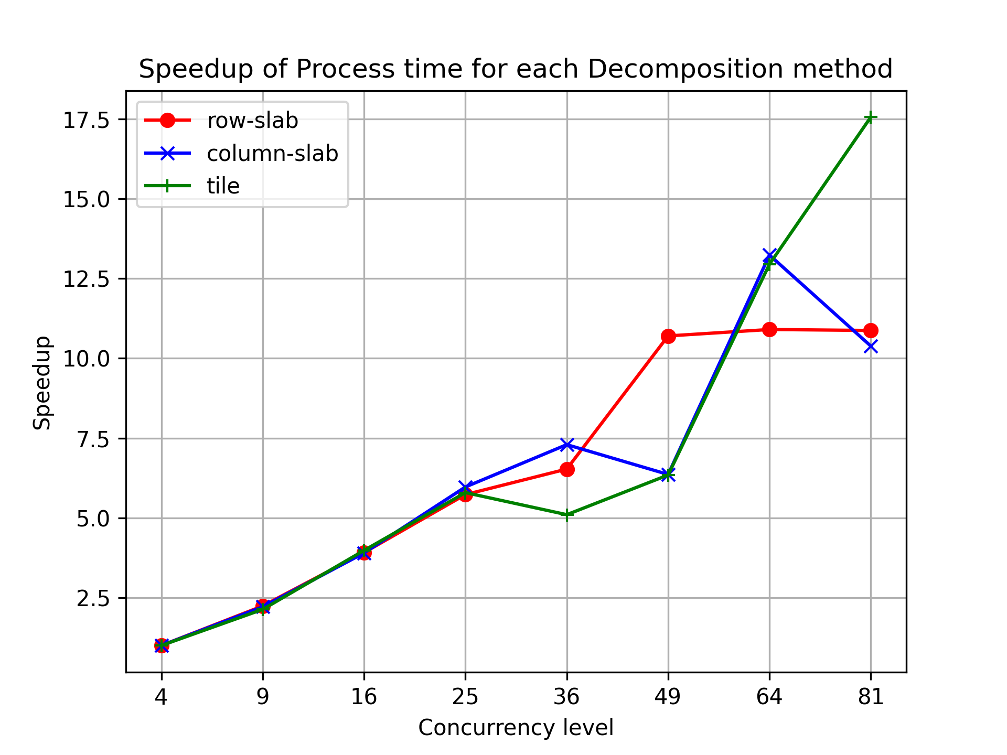
Result
Process speed up
The process stage revealed a marked improvement in speedup for all strategies with increasing concurrency levels, particularly noticeable for the tile strategy at the highest concurrency level of 81. Row-slab and column-slab strategies displayed similar performance until a concurrency level of 64, after which the tile strategy's speedup surged ahead

Slide 10
speedup Analysis
In scatter and gather stages, a decrease in speedup with increased concurrency levels was observed across all strategies. This pattern suggests that communication overhead becomes more significant at higher concurrency levels
In the process stage, the rise in speedup at higher concurrency levels across all strategies indicates effective parallel processing. Notably, the tiled strategy excelled at the highest concurrency, suggesting superior scalability and efficient utilization of parallel computation resources.

Slide 11
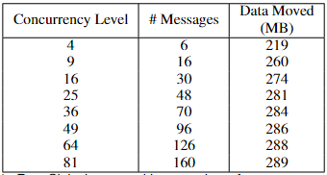
Result
Communication efficiency
As concurrency grows, so does the communication load, regardless of the decomposition method. This increase is linear for message counts and data volume.

Slide 12
Communication analysis
As concurrency grows, so does the communication load, regardless of the decomposition method. This increase is linear for message counts and less so for data volume, hinting at the fixed size of the dataset being processed.
However, when we consider how this overhead affect the scatter, process, and gather phases of execution, we anticipate that the increased messaging and data movement lead to longer runtimes for the scatter and gather phases. However, the processing phase gain the increasing in runtime thanks to the benefits of parallel processing.

